Slide 1


Healthcare Predictive Analytics – Diabetes Prediction
Presented by Mohamed Mahmoud, Abdulrahman Ahmed, Youssef Mohamed, Ahmed Wael, Amr Yasser, and Mostafa Hamdy.
by Ahmed Wael

Slide 2

Introduction – Problem Statement & Importance
Rising Global Prevalence
Early Prediction
Healthcare Impact
Diabetes is a growing chronic disease worldwide with severe complications.
Enables proactive medical decisions and prevention of advanced disease stages.
Reduces burden on healthcare systems through scalable AI-powered interventions.

Slide 3
Project Objectives & Motivation
Objectives
Motivation
Predict diabetes risk using machine learning.
Millions undiagnosed globally.
Analyze medical and demographic data.
Early detection improves outcomes.
Build clinician-friendly interfaces.
Data-driven care increases efficiency.

Slide 4

Dataset Description & Source
Source & Size
Features
Kaggle dataset with 100,000 patient records.
Gender, age, BMI
Blood glucose, HbA1c
Target: diabetes diagnosis
Challenges
Missing values
4,969 duplicate records
Imbalanced classes (91.5% non-diabetic)

Slide 5
Data Cleaning & Preprocessing
Duplicate Removal
Missing Data
Normalization & Balance
Dropped 4,969 duplicate rows to ensure data integrity.
Used K-Nearest Neighbors imputation for missing values.
Scaled features and flagged class imbalance early for modeling.

Slide 6
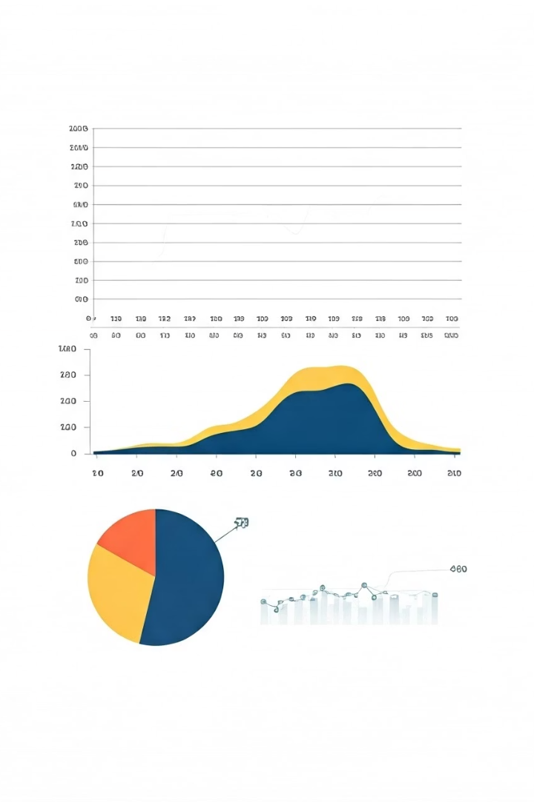
Exploratory Data Analysis – Demographics
Age Distribution
BMI Overview
Mean age 41.89 years, range from infant to 80 years.
Average BMI 27.32, highlighting weight variance.
Gender Balance
Even distribution between male and female participants.

Slide 7
Exploratory Data Analysis – Clinical Features
Blood Glucose Levels
HbA1c Statistics
Diabetes Prevalence
Mean 138.06 mg/dL, indicating varied glycemic control.
Mean of 5.53%, reflecting long-term glucose levels.
8.5% diabetic, majority non-diabetic (91.5%).

Slide 8
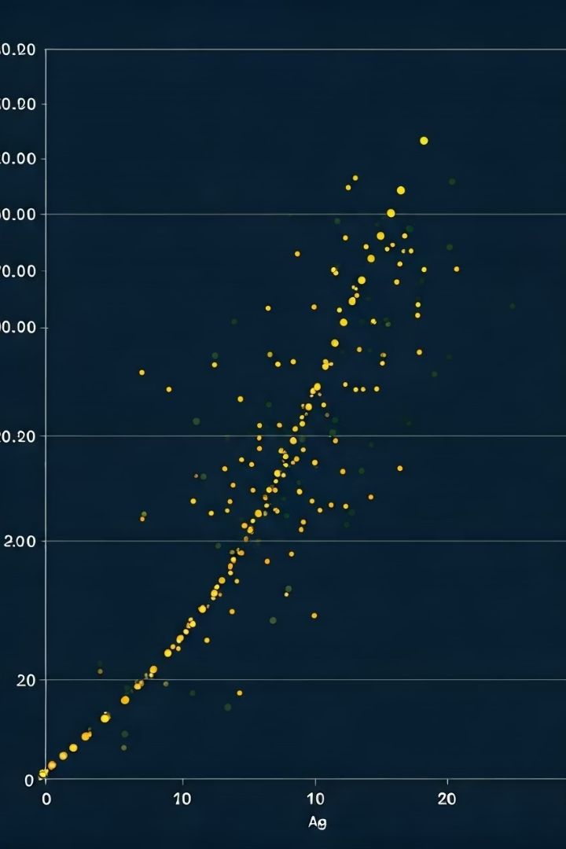
Correlation Analysis – Age & Diabetes
Higher Age, Higher Risk
Significant Patterns
Older age groups show distinct higher prevalence.
Clear trend of increased diabetes likelihood with age.
Model Implication
Age is a strong predictor in diabetes risk models.

Slide 9
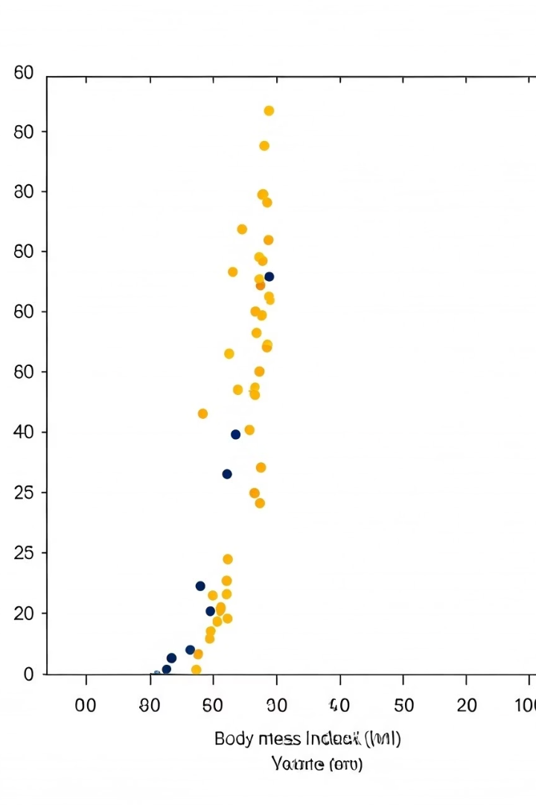
Correlation Analysis – BMI & Diabetes
High BMI, Elevates Risk
Health Insight
BMI is a critical factor in predictive modeling.
Overweight and obese individuals face greater diabetes risk.
Preventive Focus
Addressing weight control can reduce diabetes incidence.

Slide 10
Feature Engineering & Selection
New Features
Feature Importance
Optimization
Created BMI categories based on medical guidelines.
Used Random Forest to rank impactful features.
Selected top features: Age, BMI, Blood Glucose, HbA1c.

Slide 11

Healthcare Predictive Analytics: Diabetes Prediction
: Data handling, model development, evaluation, and deployment plans.

Slide 12
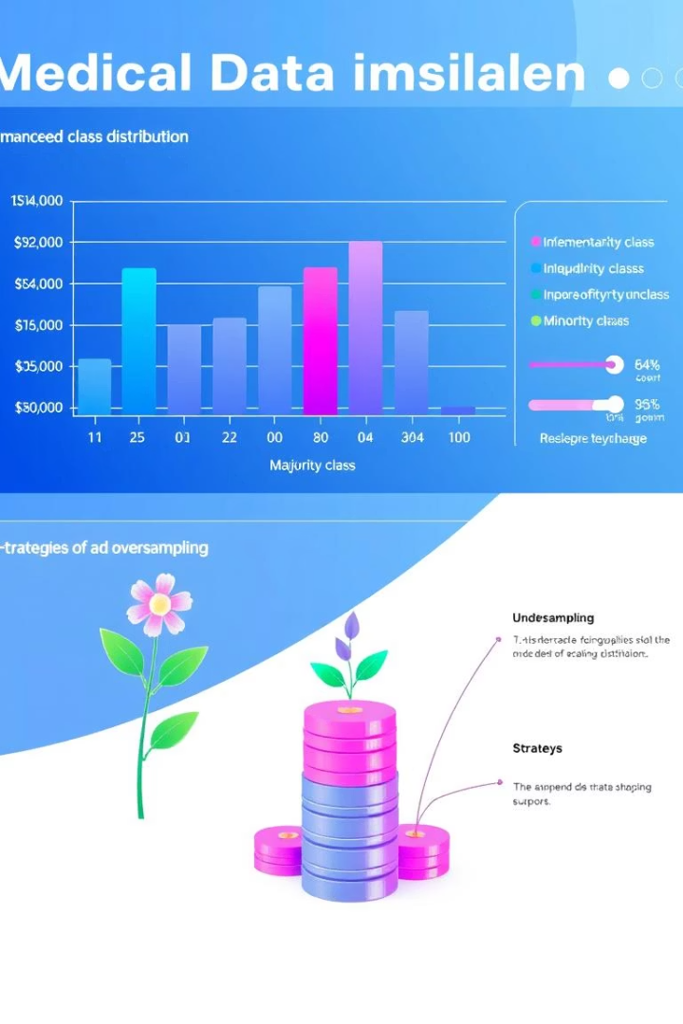
Handling Data Imbalance
Problem
Solutions Applied
91.5% of patients are non-diabetic causing imbalance.
SMOTE to generate synthetic diabetic cases
Adjusted class weights in classifiers
Goal
Ensure fairness and prevent bias towards majority class.

Slide 13

Model Training Workflow
1
Data Preparation
Split data into train and test sets.
2
Cross-Validation
Ensure model robustness across folds.
3
Hyperparameter Tuning
Optimize using GridSearchCV.
4
Evaluation & Selection
Assess performance and choose best model.

Slide 14
Logistic Regression Results
Performance
Pros
Accuracy: ~88%
Simple and interpretable model.
Precision: 0.65
Cons
Recall: 0.72
Limited for complex, non-linear patterns.
Use Case
Serves as baseline for comparison.

Slide 15
Decision Tree & Random Forest Results
Decision Tree
Random Forest
Accuracy: ~90%
Accuracy: ~93%
Highly interpretable
Better generalization
Prone to overfitting
Insightful feature importance

Slide 16
SVM & Neural Network Results
SVM
Neural Network
Accuracy: ~91%
Accuracy: ~95%
Effective for high-dimensional data
Excels in complex relationships

Slide 17
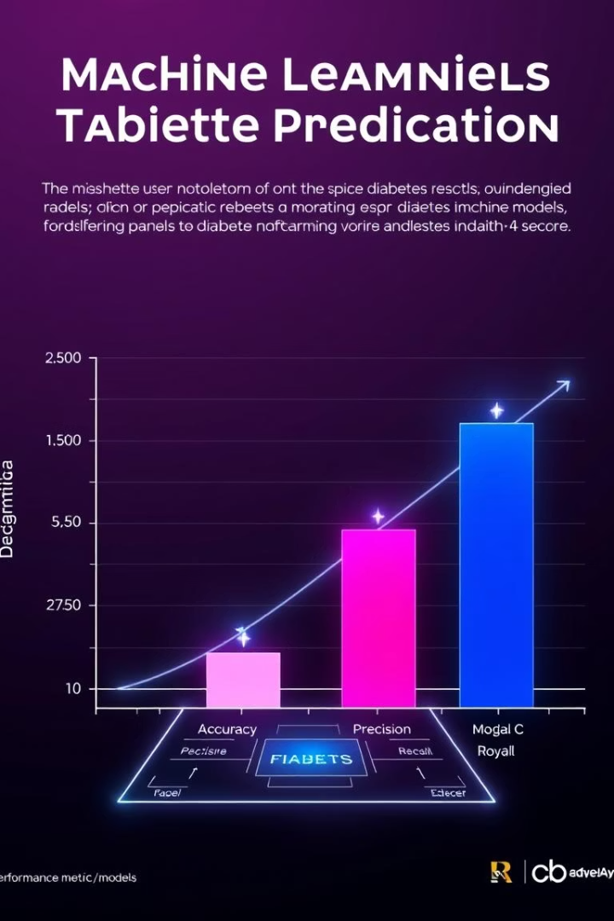
Model Comparison & Selection
Model
Accuracy
Precision
Recall
F1-Score
Logistic Regression
88%
0.65
0.72
0.68
Decision Tree
90%
0.70
0.76
0.73
Random Forest
93%
0.82
0.85
0.83
SVM
91%
0.78
0.80
0.79
Neural Network
95%
0.88
0.90
0.89
Selected Model: Neural Network for best overall performance.

Slide 18
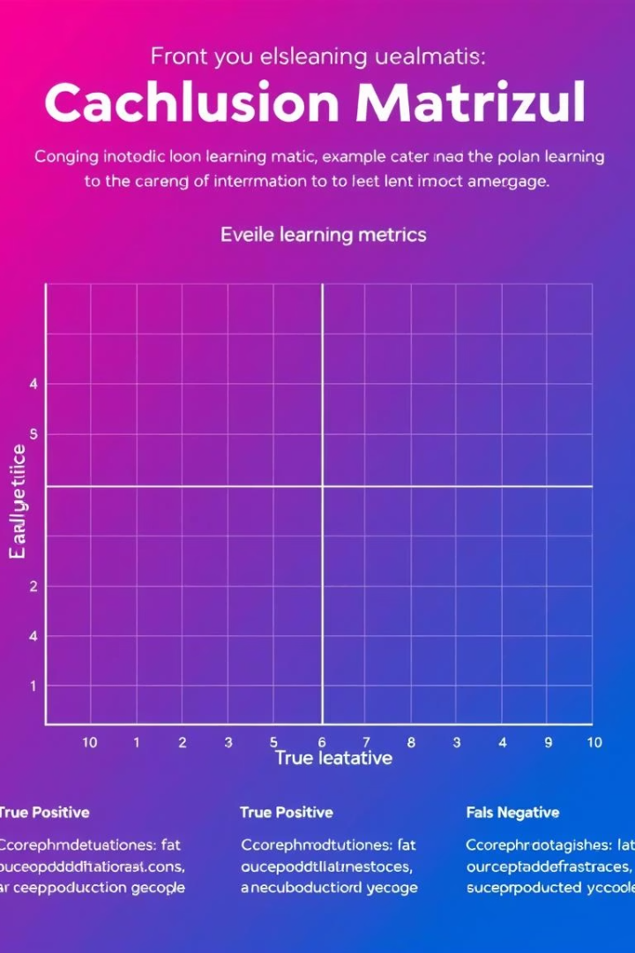
Model Evaluation Metrics
Confusion Matrix
Inference Time
Visualizes True/False Positives & Negatives.
Tested for real-time deployment feasibility.
Class Balance Score
Ensured fairness after oversampling.
Outcome: High-performing, unbiased model ready for deployment.

Slide 19
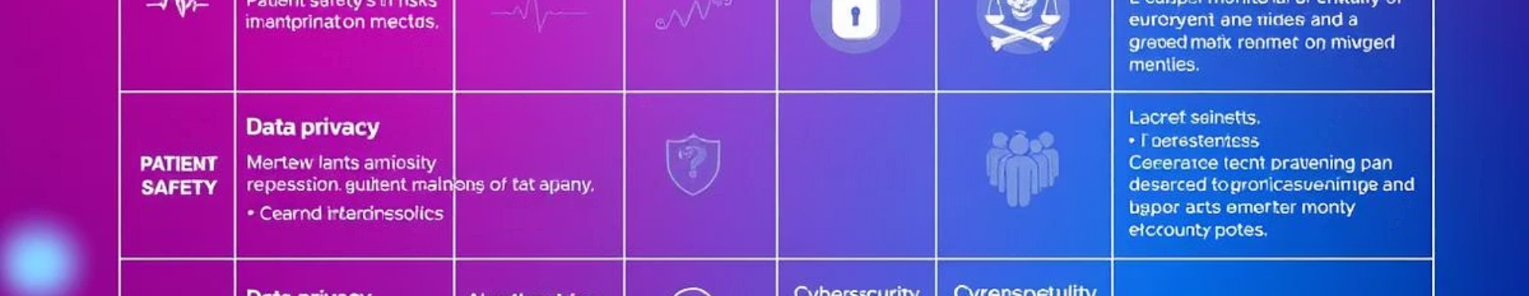
Risks & Mitigation Strategies
Risk
Impact
Mitigation
Data Quality
Low accuracy
Data cleaning, KNN imputation
Overfitting
Poor generalization
Regularization, Dropout, Cross-validation
Imbalanced Data
Biased predictions
SMOTE, class weights adjustment

Slide 20
Deployment Plan & Future Steps
Deployment
Future Enhancements
RESTful API for clinical use
Incorporate real-time data
Integration with healthcare professionals
Wearable device integration
Continuous monitoring post-deployment
Expand dataset with more features
AI is set to revolutionize preventive healthcare through predictive analytics.

